Slide 1
Patient Similarity Networks

Slide 2
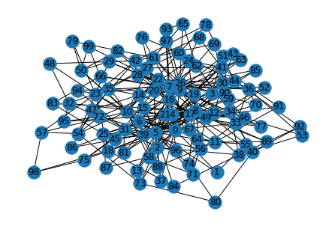
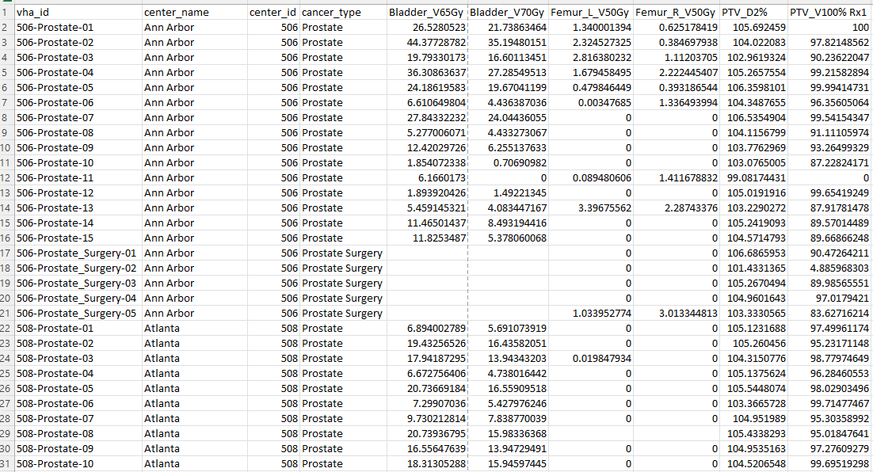
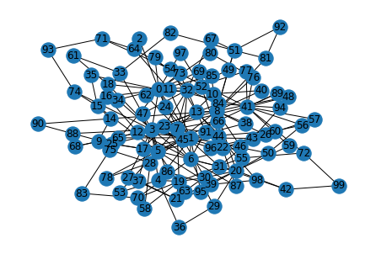
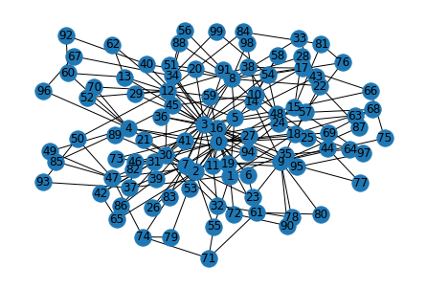
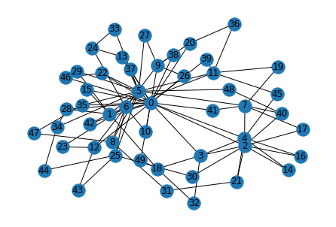
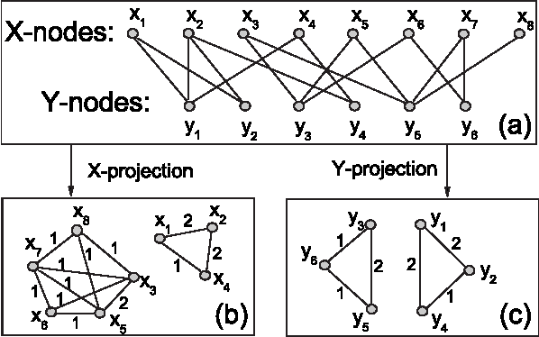
F1, f2, …, fm
P1
P2
P3
..
Pn
F1, f2, …, f_d
P1
P2
P3
..
Pn
F1, f2, …, f_t
P1
P2
P3
..
Pn

Slide 3
PSN construction
Classic distance
Kernel function
Kernels on graphs
Data are normalized and homogenous
Continuous and normalized data: (Cosine similarity, Euclidean, Mahalanobis)
Discrete data : Chi-Squared distance
Binary data: Jaccard distance (+76 metrics more)
Heterogenous data
Supervised Cox regression
Learn weights for variables
Use learnt weights to compute similarity score as a weighted sum of individual similarities obtained on each feature by using standard metrics.
Continuous non-normalized variables
Compute the average of all normalized similarities over each variable, where the normalization is essentially a min-max normalization.

Slide 4
PSN construction
Classic distance
Kernel function
Kernels on graphs

Slide 5

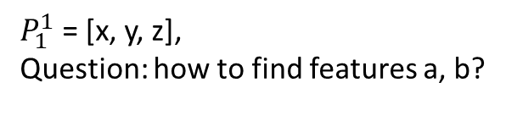


X, y, z
X, y, a, b
P1
P2
P3
..
Pn
$$P1$$
$$P2$$
$$P3$$
$$..$$
$$P_{m}$$
$$x, y, a, b, z$$
P1
P2
P3
..
$$P_{n+m}$$
$P_{1}^{1}$ = [x, y, z],
Question: how to find features a, b?

